Slide 1

Technical Assistance to
National Academy of Vocational
Training (NAVT)
for
effective implementation of
Workplace-based
(Apprenticeship)
Training
Workplace-Based Training Curriculum Development Process
Deepak Prasad Poudel
Skill Development and Training Specialist
HELVETAS Nepal
NAVT, Lalitpur, 09 February 2025

Slide 2
Presentation Outline
Curriculum Development and Revision Process
DACUM Process
Course Structure Development Process
Task Analysis Process
Curriculum Finalization
Approval, Dissemination, and Implementation

Slide 3
Curriculum Development and Revision Process
Policy Level
8-12 Industries Experts, Trainers
4-6 Industries Experts, Trainers, Academician
8-12 Industries Experts, Trainers, Academician
8-12 Industries Supervisor, Trainer
8-12 Expert Workers
Demand from Industries
Approval/Dissemination/Implementation
DACUM Workshop
ROA
Verification Workshop
Course Structure Development
Technical Committee Review and Finalize
Task Analysis
½ Day
2 days
6-10 days
1 day
1 day
2 days
1-2 days
Stakeholders Involvement
Activities
Durations

Slide 4
Rapid Occupational Analysis (ROA)
Conduct Rapid Occupational Analysis (ROA):
  Get approval from authorized body
  Collect data about: the nature of the occupation(s), the demand for trained human resource in the occupation(s), the supply of trained manpower in the occupation(s).
The major outputs of occupational Analysis are:
  • Occupational outlook
  • Job title(s)
  • Job descriptions
  • Certification requirements (if any)
  • Program accreditation requirements (if any)

Slide 5
DACUM is
An acronym for Developing A CurriculUM
A tool for job analysis
A first step in curriculum development
DACUM Beliefs
Expert workers can describe and define their job more accurately than anyone else.
An effective way to describe a job is to define the tasks expert workers perform.
All tasks demand certain knowledge, skills, tools, and attitudes in order to be performed correctly.
Dr. Robert Norton
Ohio State University
Center for Education and Training for Employment

Slide 6
History of DACUM
DACUM was developed in the late 1960s as a job analysis method to define required skills and tasks for occupations.
Purpose: To create effective training programs based on real-world job requirements.
Key Contributors
Robert E. Adams (Nova Scotia Newstart, Canada)
  1960s: Initial concept and development.
Larry Coffin & Holland College (Canada)
  Collaborated to formalize the DACUM process.
Robert E. Norton (National Center for Research in Vocational Education, USA)
  Expanded DACUM's role in vocational education.
1970s: Robert L. Hoke (Ohio State University) refined DACUM for broader educational use.
Global Adoption
1970s to the 1990s, particularly in the U.S., Canada, Australia, and parts of Europe uses DACUM process for vocational and technical curriculum development.
Viet Nam: DACUM introduced by seven facilitators to vocational training centers, forming the basis for new curricula in early 2000.
Worldwide: Now a day, DACUM continues to be used internationally in vocational education.

Slide 7
DACUM Process
Preparation
Orientation
Determine duties
List out tasks
List out tools and equipment
List out related technical Knowledge
Collect other information
Review of occupation
Panel of expert workers
Workshop time, date & Venue
Facilitators & recorder
Logistic supports
Workshop schedule
DACUM overview
DACUM philosophy
Ground rules
Duties definition
Task Definition
Sample of DACUM charts
Group work
Focus on doing
Group presentation
Verification of duties
Brainstorming
List out major area of works
proper action verbs for duties
8-12 duties per job
Common duties
Rank duties on simple to complex
Task definition
Characteristics
Task identification
Brainstorming
Tasks per duty
action verbs for tasks
minimum 5 tasks per duties
Rank tasks on each duty
50-200 tasks on job
Occupation specific equipment
Hand tools
Machines
Materials
Consumable
Non-consumable items
Essential knowledge for the job
must to know
Occupation
Concepts, theories
Working principle
Classification
Advantages
Disadvantages
Methods, process
Worker’s traits
Characteristic of the job
Outlook of the job
Career path and progression
Future trends
Market demands of the job
Draft Job Profile (DACUM Chart)
Verify the draft Job Profile (DACUM Chart)
Final Job Profile (DACUM Chart)

Slide 8
Duties and Task
Duties: Describes a large area of work in performance terms
  Serves as a title for a cluster of related tasks
  Is a general statement of work that is performed (NOT specific)
  Is a meaningful, stand-alone statement without reference to a job
  Usually 8 to 12 duties per job.
Task: A task describes a specific area of work which,
  is specific
  is observable
  is a unit of work complete in itself
  can be broken down into two or more steps
  can be performed in a limited period of time
  has a definite start and end point
  when completed results in a product, service, or decision
  is something a worker is normally paid to do.
  has a SINGLE action verb focus on DOING.

Slide 9
DACUM Outcomes
DACUM Chart: Cook
Duties | Tasks
A. Cook Meats | A.1 Boil meats | A.2 Fry meats | A.3 Grill meats | A.4 Stir-fry meats
B . Cook Fish | B.1 Boil fish | B.2 Grill fish | B.3 Bake fish | B.4 Fry fish
C. Cook Vegetables | C.1 Boil Vegetables | C.2 Steam vegetables | C.3 Stir-fry vegetables | C.4 Grill Vegetables
D . Prepare dishes for serving | D.1 Garnish dishes with parsley | D.2 Garnish dishes with sauces | D.3 Garnish dishes with cut vegetables | D.4 Arrange entrees on plate

Slide 10
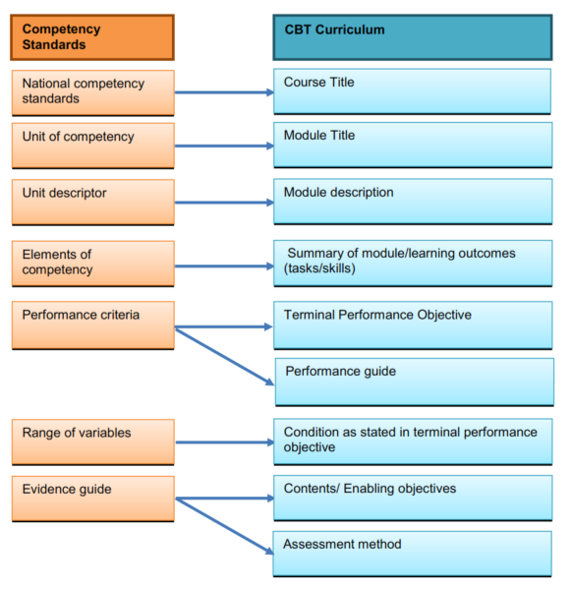
Analyze the occupational standard and its units of competencies with DACUM Chart and curriculum

Slide 11
Course Structure Development Process
Preparation
Panel of experts’ representative from industry, Supervisors, Academia, Instructors
Format of course structure
Determine units or sub unit
Name of the Unit, sub unit for vocational curriculum
Nature of Instruction (Theory, Practical)
Determine the nature of delivery, lecture for theory, demo, guided practice and individual practice for practical
Allocate contact hours
Determine the class hours for theory and practical
Determine Credit
Determine the credit of the unit as per rule of 1:2:4 (1 credit: 15-20 hrs for lecture, 30-40 hrs. for practical, and 60-80 hrs. for OJT or WBT)
Evaluation scheme
Determine the evaluation based on formative and summative evaluation
Full Marks or Grading System
Determine the marks for evaluation in figure and alphabet system
Final Course Structure
Develop a course structure based on the format as prescribed

Slide 12
पाठ्य संरचना (Course Structure)
एकाइ | शीर्षक | समय अवधि घण्टा |  |  | क्रेडिट | पुर्णाङ्क | ग्रेड
 |  | सैद्धान्तिक | प्रयोगात्मक | जम्मा
१ | पेशागत परिचय
२ | व्यावसायिक स्वास्थ्य र सुरक्षा
३ | पेशागत सीपका क्षेत्र (एकाइ १)
४ | पेशागत सीपका क्षेत्र (एकाइ २)
५ | पेशागत सीपका क्षेत्र (एकाइ ३)
६ | आधारभुत सीपका क्षेत्र (साक्षरता, सूचना प्रविधि र हरित, उद्यमशिलता)
७ | ओजेटी वा कार्यस्थलमा आधारित तालिम
 | जम्मा
क्रेडिट निर्धारणका आधार:
सैद्धान्तिकः १ क्रेडिट = १५-२० कक्षा घण्टा; प्रयोगात्मकः १ क्रेडिट = ३०-४० प्रयोगात्मक घण्टा;
ओजेटी वा कार्यस्थलमा आधारित तालिमः १ क्रेडिट = ६०-८० कार्य घण्टा

Slide 13
कार्य विश्लेषणको नमूना
एकाइ (Unit): ……………..
एकाइ विवरण (Unit Description):
एकाइको सिकाइ उपलब्धी (Unit Outcome):
कार्यहरू (Tasks): १ ……………… २ …………….. ३ …………………… ४ ……………………
समय (Duration): सैद्धान्तिक .. घण्टा + व्यावहारिक … घण्टा = …. घण्टा

Slide 14
एकाइ (Unit): …………………………….. निर्दिष्ट कार्य १: ………………………
समय (Duration): सैद्धान्तिक …. घण्टा + व्यावहारिक …… घण्टा = …… घण्टा
कार्य चरणहरु (Performance Steps) | अन्तिम कार्य सम्पादनको उद्देश्य (Terminal Performance Objective) | सम्बन्धित प्राविधिक ज्ञान (Related Technical Knowledge)
१ ……………. २ …………… ३ …………….. ४ …………… ५ ……………….. | दिइएको अवस्था (Condition (Given): निर्दिश्ट कार्य Task): मापदण्ड (Standard):
आवश्यक औजार उपकरण (Required tools/equipment):
सुरक्षा सावधानी (Safety Precautions):

Slide 15
Review, Finalize and approve the Curriculum
Select the panel members
Finalize the date, time and venue for meeting
Communicate and confirmation of participation
Distribute the draft copy of curriculum in advance
Review whole curriculum (course structure, duties, tasks, task analysis, etc.), edit and finalize
Recommend for final approval.
Get approval from authorized body.
Disseminate and implement.

Slide 16
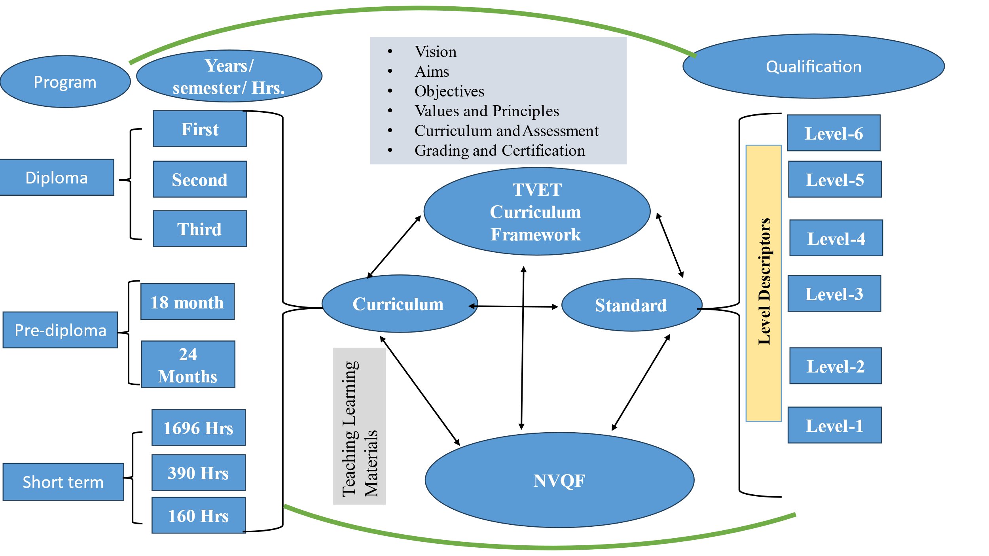
Relationship Between NVQF and Curriculum

Slide 17
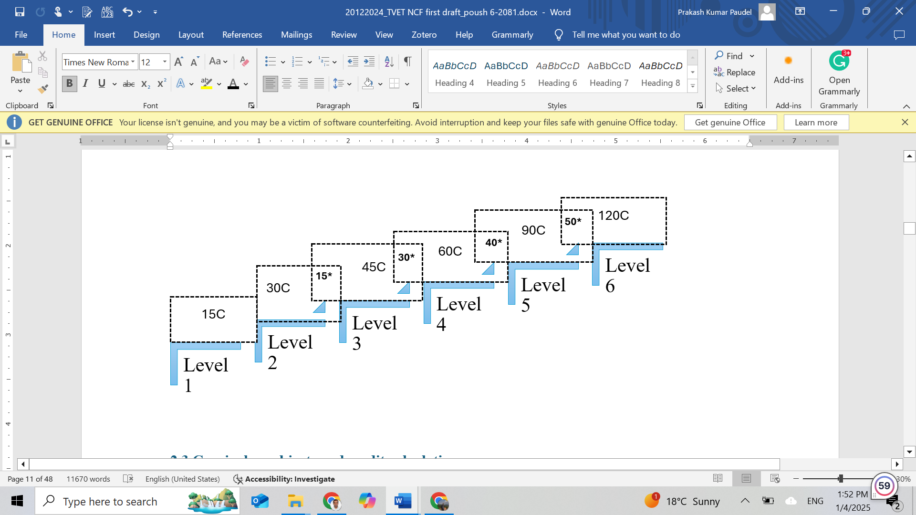
Credit and Credit Transfer Standards

Slide 18
Modular Curriculum Approaches
Exit with Qualification Certificate
Shoemaking sector
Introduction (M1)
Occupational Health and Safety (M2)
Designing (M3)
Cutting (M4)
Stitching (M5)
Lasting (M6)
Pasting (M7)
Finishing (M8)
Entry
M1 + M2 + M8
Exit with
Occupation
(Unit) Certificate
M1 + M2 + M5
M1 + M2 + M4
M1 + M2 + M3
M1 = Basic Module
M2 = Sectoral Common Module
M3 to M8 = Occupational Module

Slide 19
Level Descriptors of NVQF
Level | Theoretical Knowledge | Professional Skills | Soft Skills | Performance Outcomes | Level of Responsibility
1 | Basic general knowledge | Basic general skills | Readiness to work | Familiar to the occupation | Assist to work and requires full supervision.
2 | Fundamental knowledge | ability to solve routine problems | Readiness to employment | Carry out pre- defined tasks | work with partial supervision.
3 | Wide range of knowledge | some autonomy in problem-solving. | Equip with employability skills | Perform wide range of tasks | Responsible and work without supervision.
4 | Specialized knowledge | ability to generate solutions. | Equip with team work, and Entrepreneurship skills | Perform specialized and complex tasks | Fully responsible and can also supervise others
5 | Multidisciplinary and specialized knowledge | Specialized skills for problem-solving. | Exhibit leadership and managerial skills | Perform specialized, judgmental decision making | Highly responsible and can operate own business
6 | Advance range of knowledge | Specialized skills for advanced problem-solving. | Equip with transformational leadership and effective resource management skills | Perform complex problem by appling advance technical skills | Manage business and industry

Slide 20
Vocational Training Curriculum Template

Slide 21
जिज्ञासाको अपेक्षा सहित
धन्यवाद।

